Slide 1

Welcome back!
Start implementing hello, mario in Python for PSET6!

Slide 2
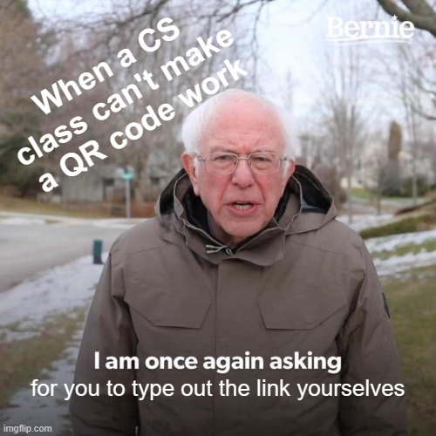
cs50.ly/section_attendance

Slide 3
cs50 section 6
Python
Andrew Holmes 2023

Slide 4
Today’s plan
Andrew is getting his ass kicked, there is no plan

Slide 5
01
Python basics
Bringing back some familiar friends in weird Halloween syntax costumes.

Slide 6
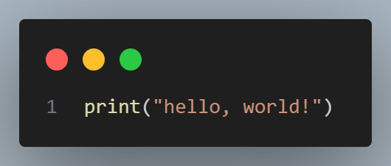
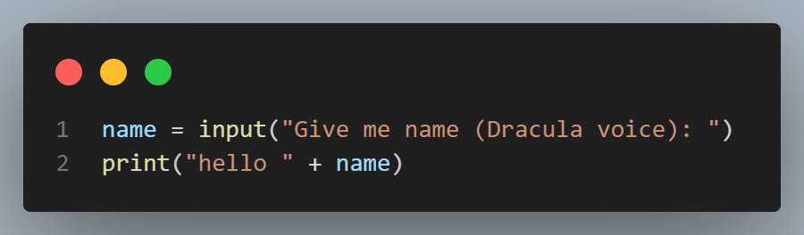
Basic python file
Basics

Slide 7
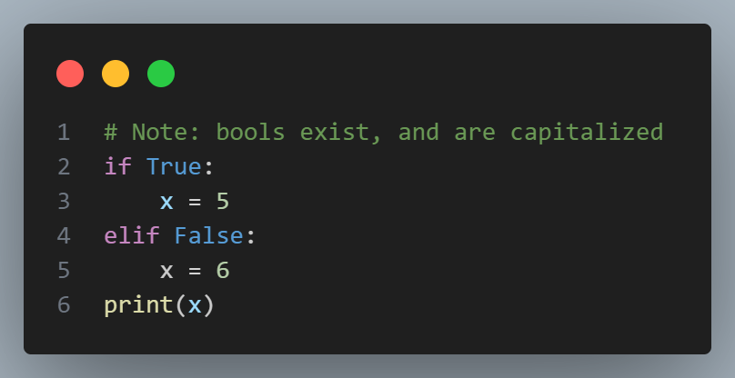
Conditionals
Basics
True is capitalized in Python
No curly braces! IDENTATION MATTERS
Not else if

Slide 8
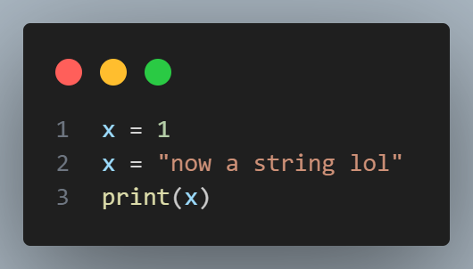
Types
Basics
Python still has types, but functions don’t enforce type checks, and you can check the type of a variable whenever. You also don’t have to declare it’s type, Python works it out for you.

Slide 9
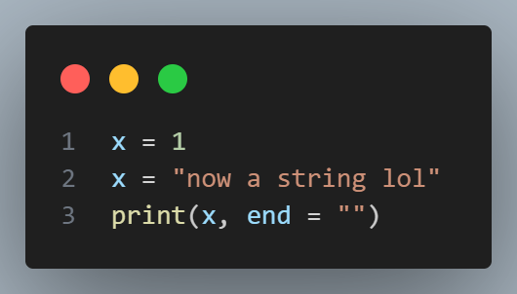
Types
Basics
But wait, this prints a newline! I didn’t put it there…
Python puts a newline by default at the end of every print statements.
Mario ☹

Slide 10

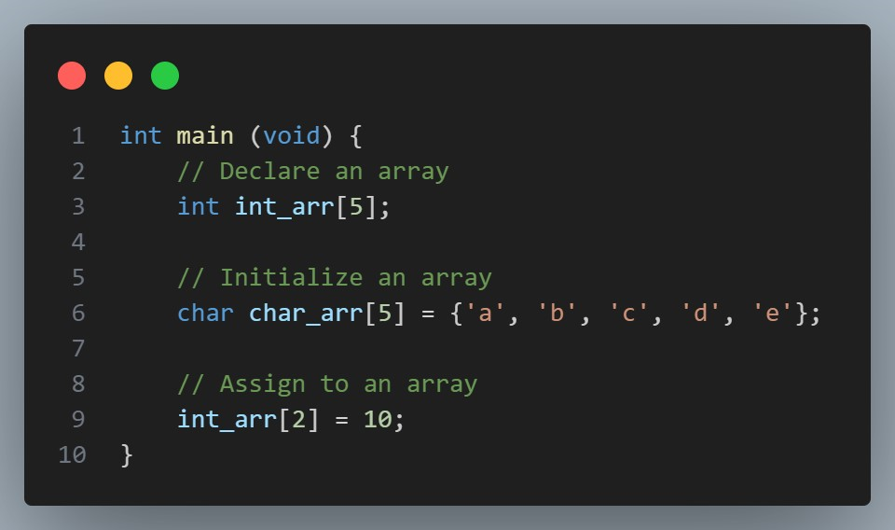
Compiled languages (e.g. C)
Basics
2
compiled.o
1
Compiler error, can’t even compile let alone run

Slide 11
Compiled languages (e.g. C)
run step
Basics
2
3
1
source.c
compiled.o
Type checking
correct syntax
library imports
etc
runtime errors e.g.
segfaults
CTRL + C
Compiler step

Slide 12
Interpreted languages (Python!)
Basics
1
2
3
4
5
6

Slide 13
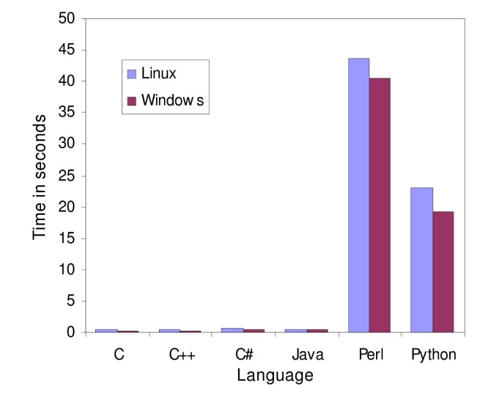
Why not always use interpreted? Compiling is annoying
Basics
‘Implementations in C and C++ were fastest and used the least memory. Programs in these languages generally contained more lines of code. Java and C# appeared to be a compromise between the flexibility of Perl and Python and the fast performance of C and C++.’

Slide 14
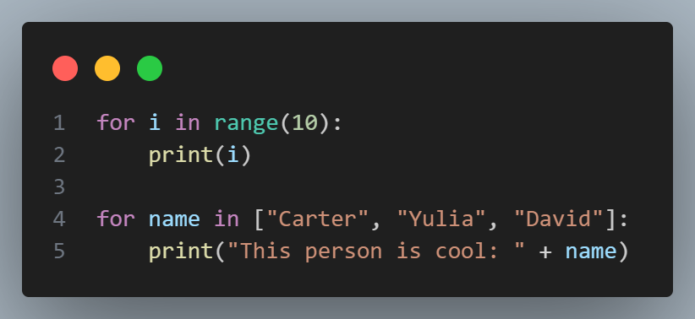
For loops
Basics
To get the classic `(int i = 0; i < 10; i++)`, we use range:
But we can also just get elements out directly!

Slide 15
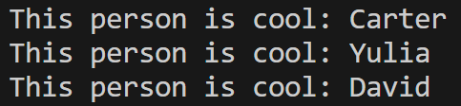
For loops
Basics

Slide 16
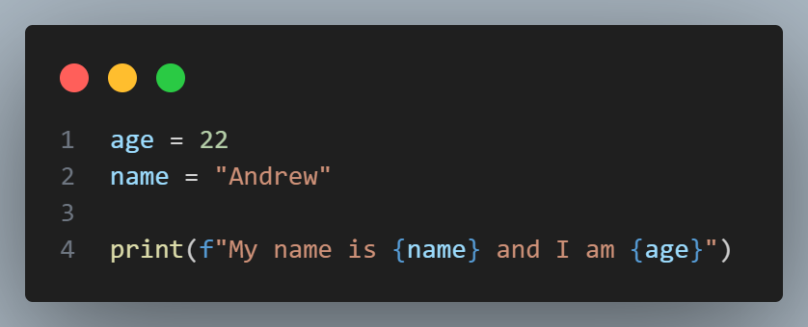
Printf
Basics

Slide 17
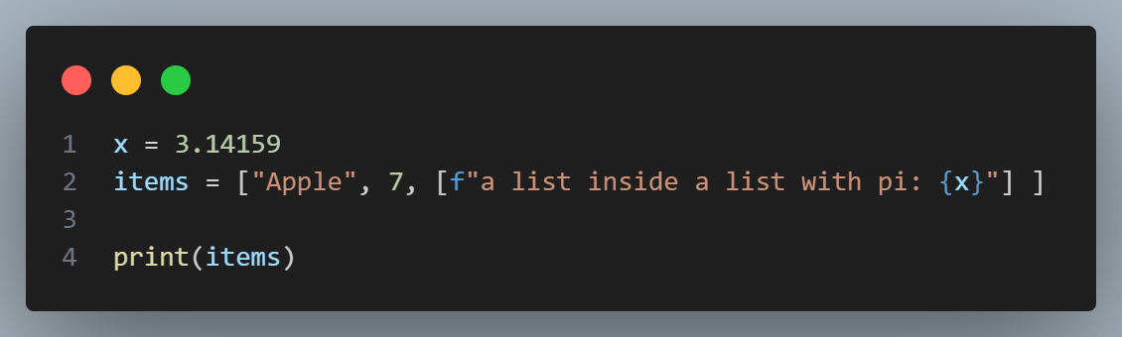
Lists
Basics
Lists in Python can contain different types, and can freely change size! They are not much like arrays in C at all.

Slide 18
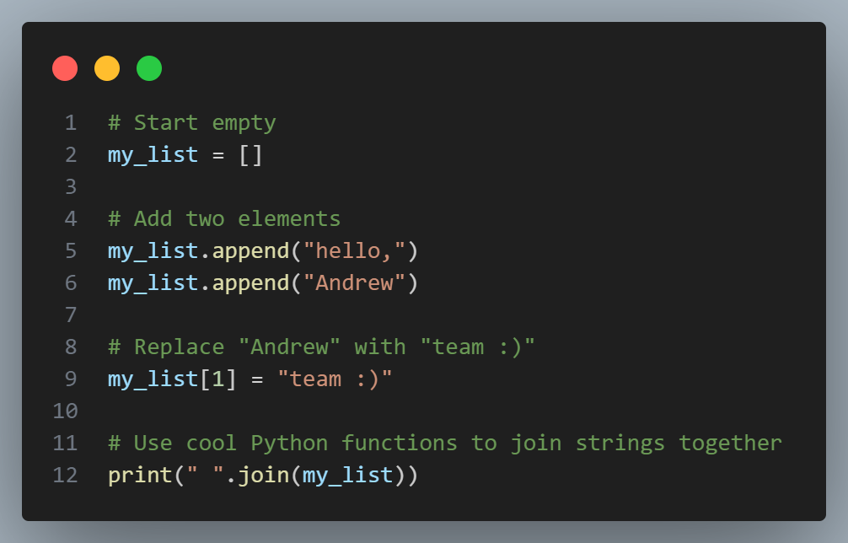
Lists
Basics
Here we create an empty list, add things to it, then index into a lit and replace an item.
the .join method operates on a string, and puts that string between every item in a list to form one whole string.

Slide 19
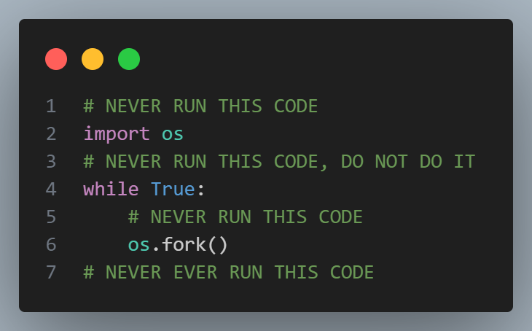
While loop
Basics
I couldn’t help myself, but please seriously never run this code. It will crash your computer, and may cause harm. It’s a famous hack in three lines of Python, looping forever and using all of your CPU capacity until you crash.

Slide 20
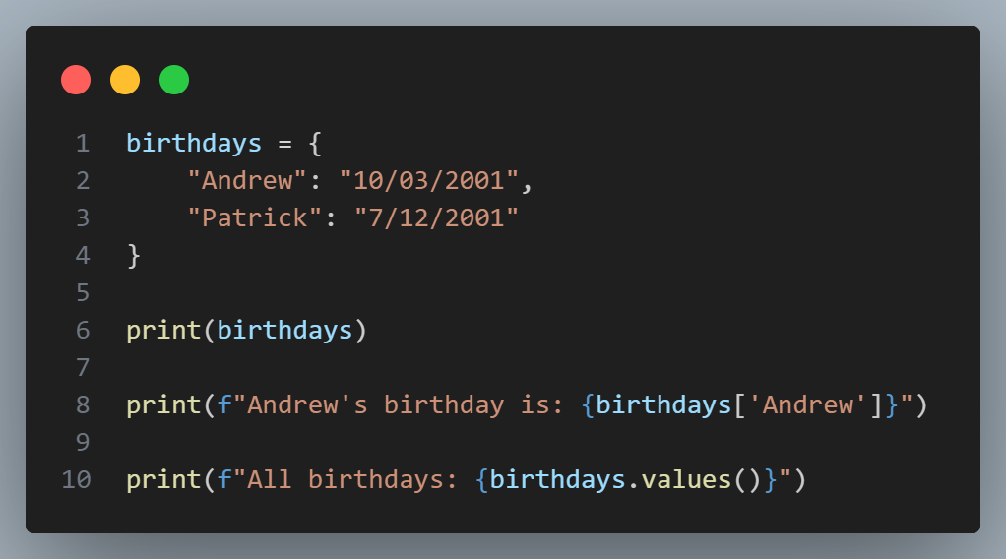
Dictionaries
Basics
Dictionaries store key-value pairs.
You can use the key to access the value corresponding to that key.
This is a hashmap made for us!

Slide 21
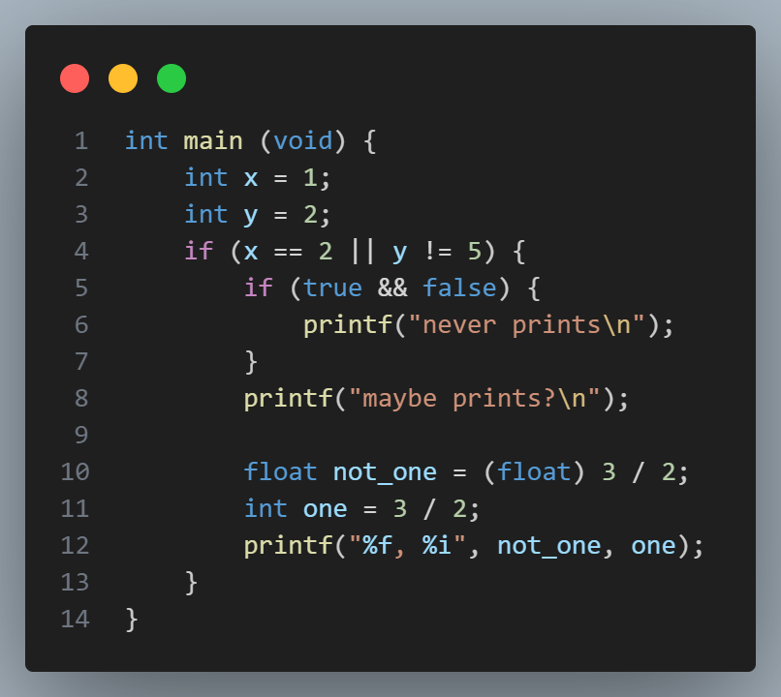
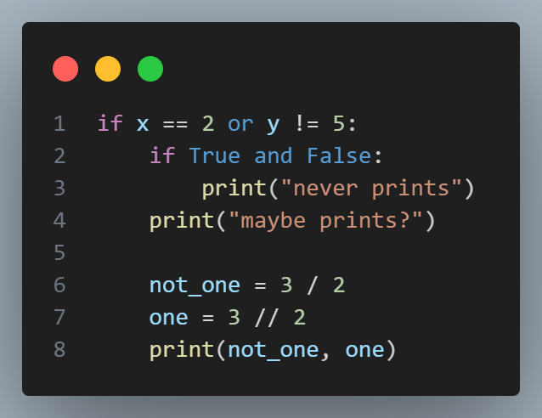
Operator translation
Basics

